Slide 1






Original
Image
Segment
Image
Generate Segment Code
Combine
Segments
Verify
Code
Final
Webpage

Slide 2
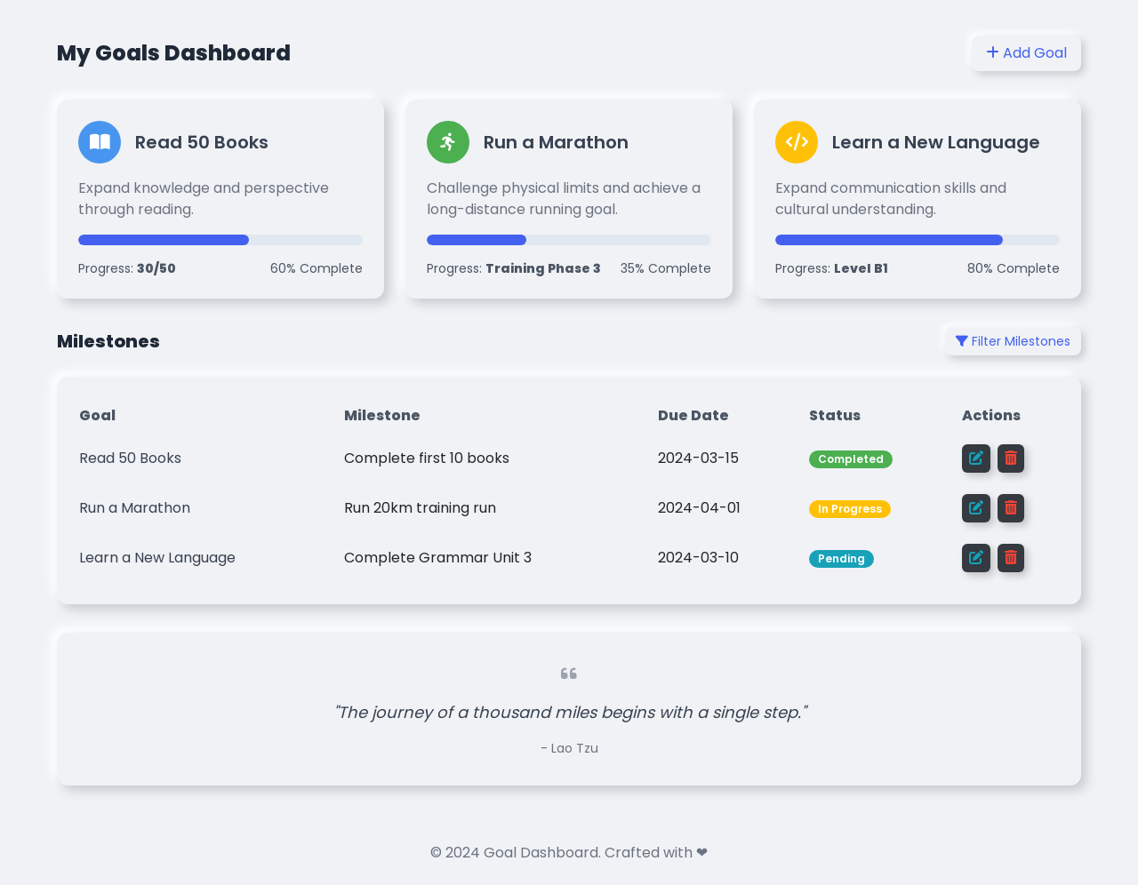
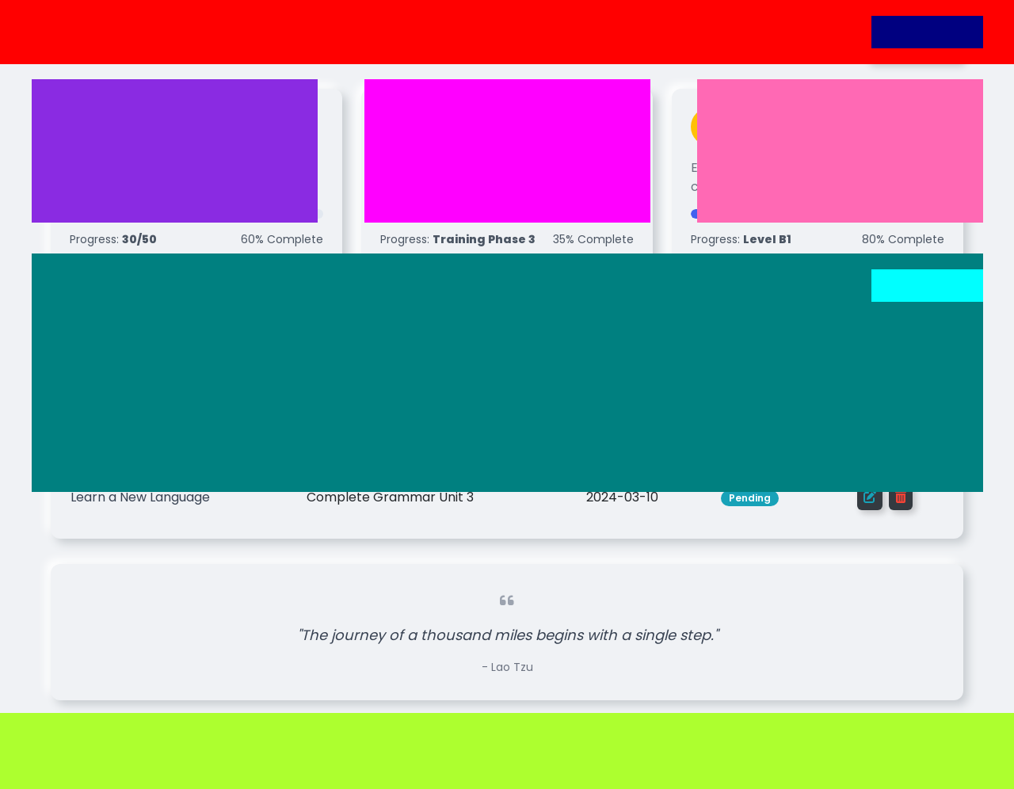






Original Image
LLM Segments
Fixed-Size Segments
Overlapping Segments

Slide 3
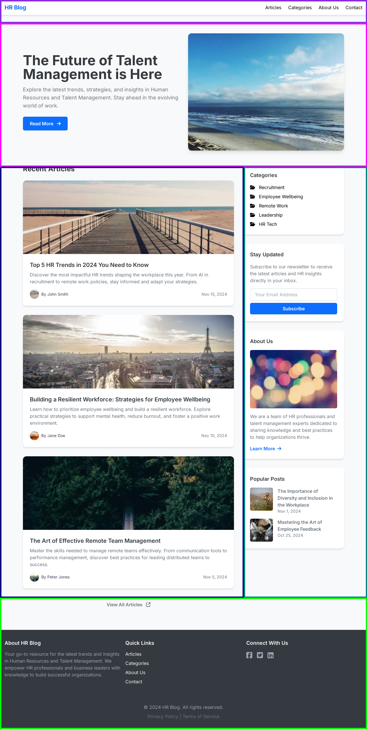
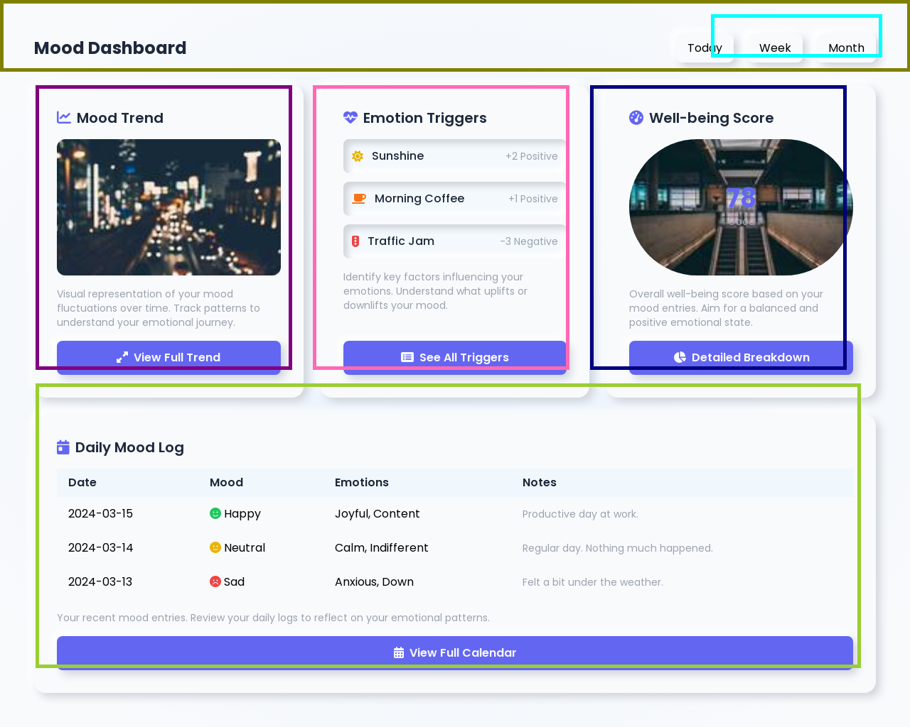
GOOD

Slide 4
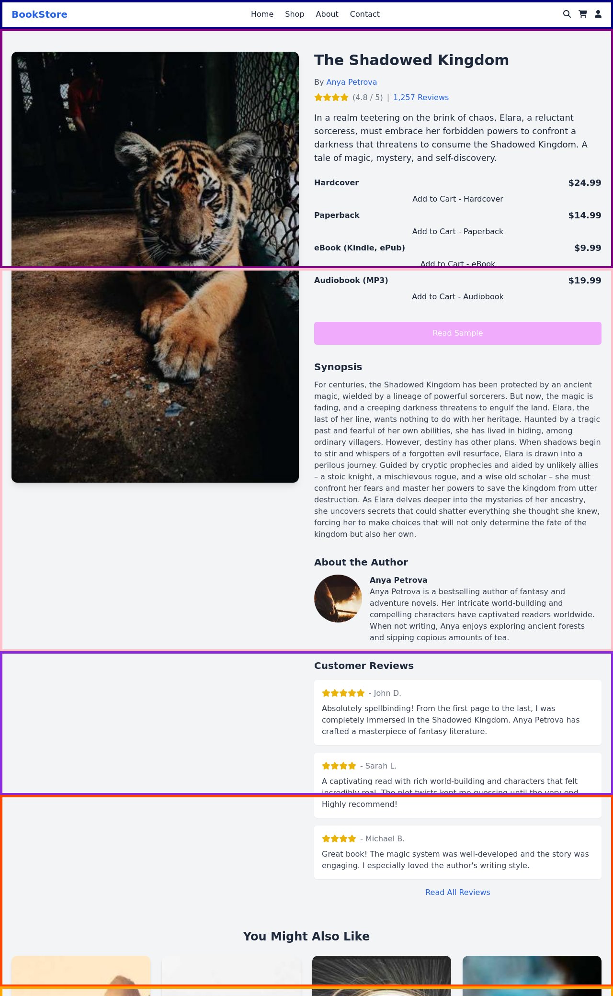
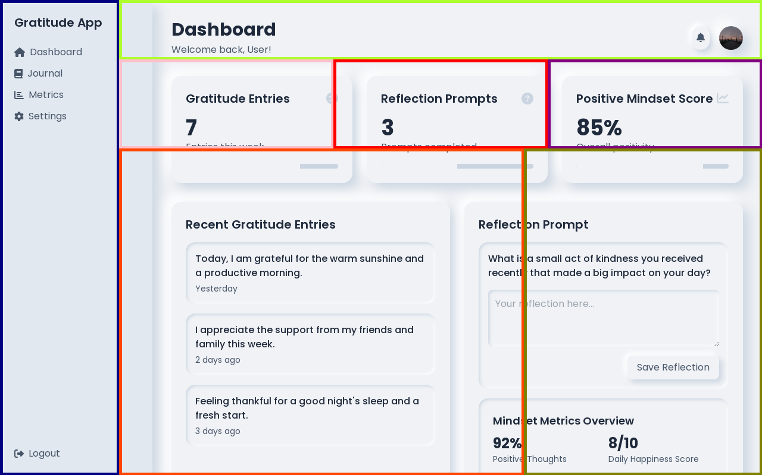
BAD

Slide 5
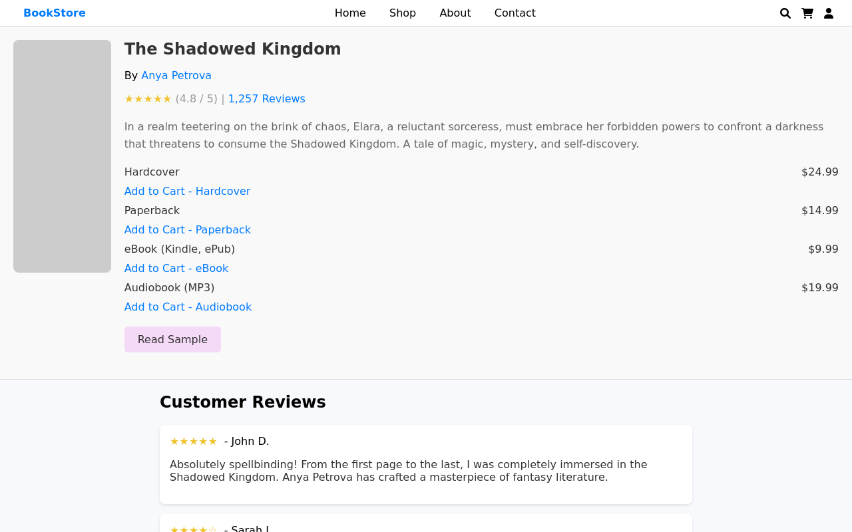
Book bad gen

Slide 6
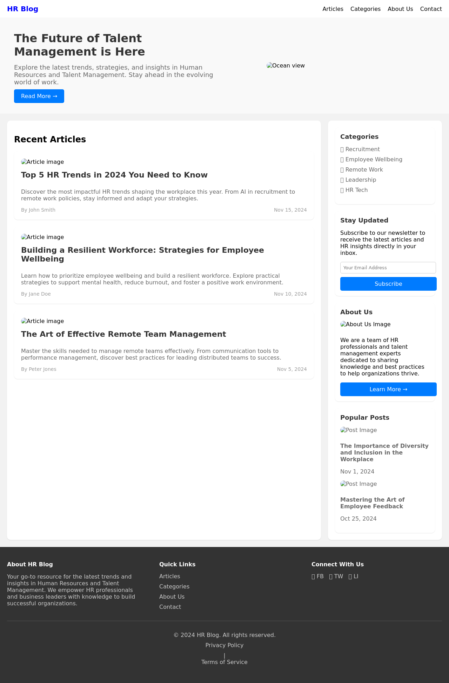
HR good gen

Slide 7
